Slide 1



GARBAGE CLASSIFICATION SYSTEM

Slide 2
Title: Intelligent Garbage Classification System Using Deep Learning
- Subtitle: Automated Waste Management Solution
- Student Name : Arshad Pahsa
- College Name : Seshadripuram Degree College ,Mysore
- Organization: AICTE Shell Skills4Future 2025-26 (Cycle1)
Source :
www.freepik.com/

Slide 3

Learning Objectives
By the end of this presentation, you will understand:
1. How to implement Transfer Learning using EfficientNetV2B2 for image classification
2. Techniques for handling imbalanced datasets in computer vision
3. Data augmentation strategies to improve model robustness
4. Building and training deep learning models using TensorFlow/Keras
5. Model evaluation techniques including confusion matrices and classification reports
6. Deployment of ML models using Gradio for web interfaces
7. End-to-end workflow for computer vision projects
8. Best practices for model optimization and performance monitoring
GOAL
Source :
www.freepik.com/

Slide 4
Tools and Technology used
Programming Language:
- Python 3.x
Deep Learning Framework:
- TensorFlow 2.x
- Keras (High-level API)
Pre-trained Model:
- EfficientNetV2B2 (ImageNet weights)
Data Processing Libraries:
- NumPy - Numerical computations
- Pandas - Data manipulation
- OpenCV/PIL - Image processing
Visualization Tools:
- Matplotlib - Plotting graphs
- Seaborn - Statistical visualizations
Machine Learning Libraries:
- scikit-learn - Model evaluation metrics
- sklearn.utils - Class weight computation
Web Interface:
- Gradio - Interactive web application
Development Environment:
- Jupyter Notebook
- VS Code

Slide 5
Methodology
5. TRAINING STRATEGY
- Class weights for imbalanced data
- Early stopping to prevent overfitting
- Learning rate reduction on plateau
- Adam optimizer with 1e-4 learning rate
6. MODEL EVALUATION
- Test set evaluation
- Confusion matrix analysis
- Classification report (precision, recall, F1-score)
7. MODEL DEPLOYMENT
- Save trained model in Keras format
- Create Gradio web interface
- Real-time prediction capability
8. PERFORMANCE MONITORING
- Training/validation curves
- Visual prediction analysis
Our approach follows a systematic 8-step process:
1. DATA COLLECTION & PREPROCESSING
- Load image dataset from directory
- Resize images to 124x124 pixels
- Split data: 80% train, 10% validation, 10% test
- Apply caching and prefetching for optimization
2. EXPLORATORY DATA ANALYSIS
- Visualize sample images from each class
- Analyze class distribution
- Identify imbalanced classes
3. DATA AUGMENTATION
- Random horizontal flip
- Random rotation (±10%)
- Random zoom (±10%)
- Random contrast adjustment
4. MODEL ARCHITECTURE
- Transfer Learning with EfficientNetV2B2
- Freeze first 100 layers
- Add custom classification head
- Global Average Pooling + Dropout + Dense layer

Slide 6
Problem Statement:
NEED FOR AUTOMATION:
- Accurate and consistent waste classification
- Reduced human intervention
- Improved recycling efficiency
- Cost-effective solution
- Real-time processing capability
TARGET CLASSES:
The system needs to classify waste into multiple categories such as:
- Organic waste
- Plastic materials
- Glass containers
- Metal objects
- Paper products
- Electronic waste
CHALLENGE:
Manual waste sorting is inefficient, time-consuming, and error-prone, leading to:
- Contamination in recycling streams
- Increased landfill waste
- Environmental pollution
- Economic losses in waste management
CURRENT ISSUES:
- Human error in waste classification
- Inconsistent sorting standards
- Labor-intensive process
- High operational costs
- Limited scalability

Slide 7
Solution:
PROPOSED APPROACH:
AI-powered Garbage Classification System using Deep Learning
KEY COMPONENTS:
1. TRANSFER LEARNING ARCHITECTURE
- Leverage EfficientNetV2B2 pre-trained on ImageNet
- Fine-tune for garbage classification task
- Achieve high accuracy with limited training data
2. ROBUST DATA PREPROCESSING
- Flexible dataset loading with multiple path options
- Automated train/validation/test splitting
- Optimized data pipeline with caching
3. ADVANCED TRAINING TECHNIQUES
- Class weight balancing for imbalanced datasets
- Data augmentation to improve generalization
- Callback mechanisms for optimal training
4. COMPREHENSIVE EVALUATION
- Multi-metric assessment (accuracy, precision, recall, F1-score)
- Visual confusion matrix analysis
- Sample prediction visualization
5. USER-FRIENDLY DEPLOYMENT
- Gradio web interface for easy access
- Real-time image classification
- Confidence score display

Slide 8
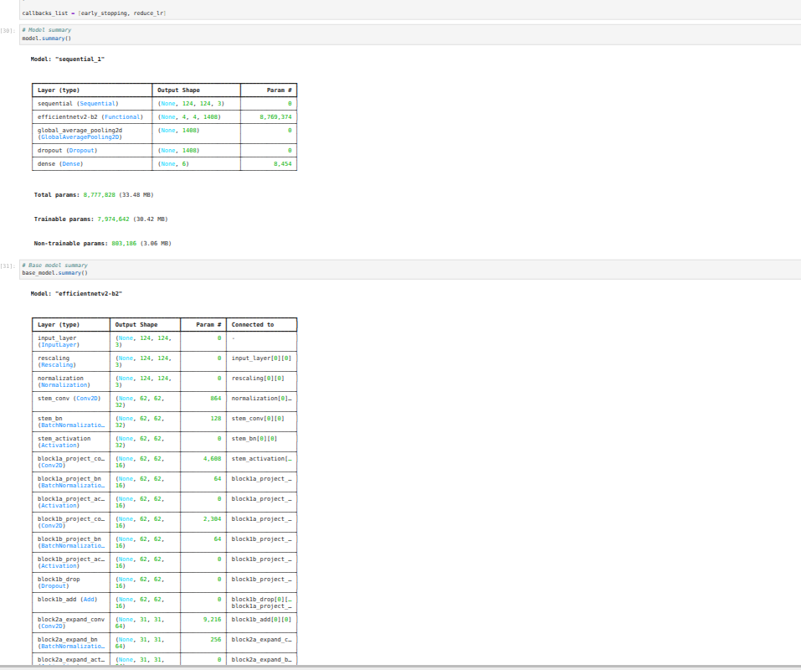
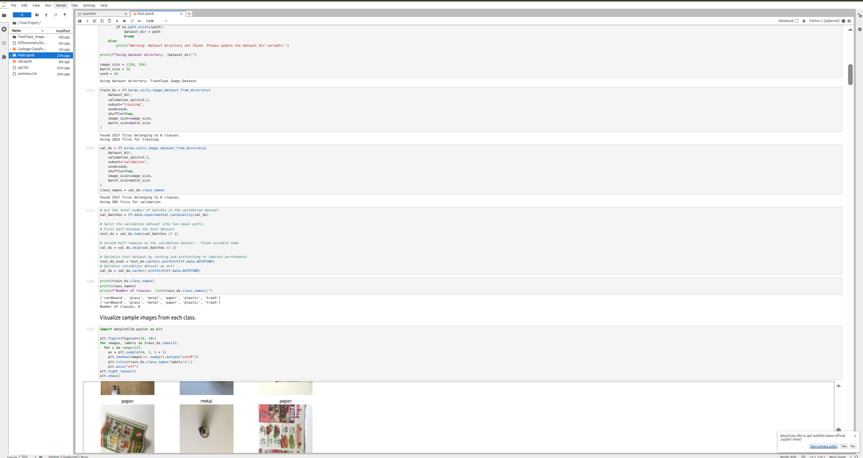
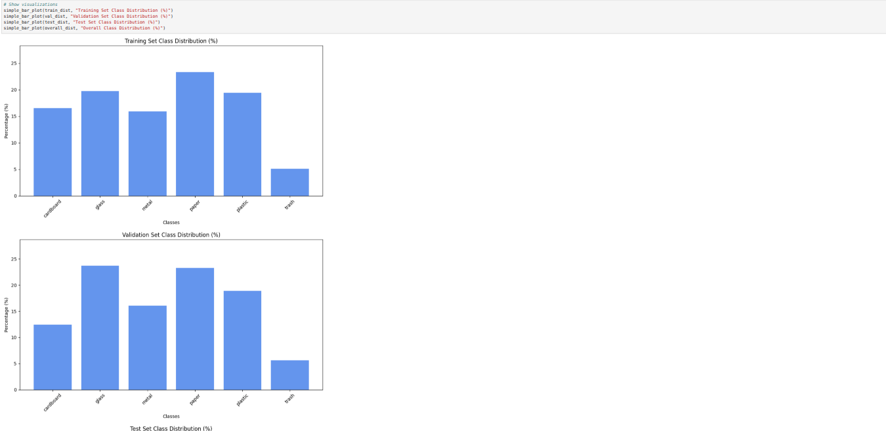
Screenshot of Output:
|

Slide 9
Conclusion:
Successfully developed an intelligent garbage classification system that:
✓ TECHNICAL ACHIEVEMENTS:
- Implemented state-of-the-art EfficientNetV2B2 architecture
- Achieved robust performance through transfer learning
- Handled imbalanced datasets with class weighting
- Created comprehensive evaluation framework
- Deployed user-friendly web interface
✓ PRACTICAL IMPACT:
- Automated waste sorting process
- Reduced classification errors
- Improved recycling efficiency
- Cost-effective solution
- Environmental sustainability contribution
✓ LEARNING OUTCOMES:
- Mastered transfer learning techniques
- Gained experience with imbalanced data handling
- Learned model deployment strategies
- Developed end-to-end ML project skills

Slide 10
Conclusion:
UTURE ENHANCEMENTS:
- Expand to more waste categories
- Implement real-time video processing
- Add mobile application interface
- Integrate with IoT sensors
- Develop batch processing capabilities
APPLICATIONS:
- Smart waste management systems
- Recycling facilities automation
- Educational tools for waste awareness
- Industrial waste processing
- Municipal waste management
FINAL THOUGHTS:
This project demonstrates the power of AI in solving real-world environmental challenges. The combination of advanced deep learning techniques with practical deployment makes it a valuable contribution to sustainable waste management practices.
Github Link : https://github.com/pashaarshad/-Garbage-Classification--AICTE-Shell-Skills4Future-2025--26--Cycle1-/blob/main/Final Project/Main.ipynb

Slide 11
Conclusion:
Successfully developed an intelligent garbage classification system that:
✓ TECHNICAL ACHIEVEMENTS:
- Implemented state-of-the-art EfficientNetV2B2 architecture
- Achieved robust performance through transfer learning
- Handled imbalanced datasets with class weighting
- Created comprehensive evaluation framework
- Deployed user-friendly web interface
✓ PRACTICAL IMPACT:
- Automated waste sorting process
- Reduced classification errors
- Improved recycling efficiency
- Cost-effective solution
- Environmental sustainability contribution
✓ LEARNING OUTCOMES:
- Mastered transfer learning techniques
- Gained experience with imbalanced data handling
- Learned model deployment strategies
- Developed end-to-end ML project skills

